Slide 1
High Performance Pattern Matching using Bloom–Bloomier Filter
Author: Nguyen Duy Anh Tuan, Bui Trung Hieu, Tran Ngoc Thinh
Presenter: Yi-Hsien Wu
Conference: Electrical Engineering/Electronics Computer Telecommunications and Information Technology (ECTI-CON), 2010 International Conference
Date: 2017/8/9
Department of Computer Science and Information Engineering
National Cheng Kung University, Taiwan R.O.C.
Notes:
1

Slide 2
Outline
Introduction
Background
System Architecture
FPGA Performance Implementation
Conclusion

Slide 3
Introduction
Nowadays, along with the development of internet, information security is becoming more and more critical. One of the most important aspects in this field is antivirus.
Although there are many improvements in antivirus programs, they still have
to match a file stream with static patterns of known viruses.
This process occupies a noticeable amount of resource and slows down entire system due to the growing number of viruses.
In addition, software-based solution can not catch up with the gigabit networks.
FPGA-based system is one of popular hardware technologies because of its high speed operation and flexibility in changing application.
Notes:
When the controller is responsible for all the tasks it becomes a bottleneck and the solution does not scale well. (reason 2)

Slide 4
Background (Bloom Filter )
Bloom Filter :
A method to use an index table to check the existence of a given string in a pre-defined set .
Initially, all entries in the 1-bit-array index table are set to '0'.
Each member of pre-defined set is then hashed to k positions in the index table by k hash functions, entries corresponding with those positions are set to '1'.
This process is repeated until all members of pre-defined set are hashed to index table.
Suppose k = 3 :
Xi = element
Notes:
When the controller is responsible for all the tasks it becomes a bottleneck and the solution does not scale well. (reason 2)

Slide 5
Background (Bloom Filter )
Membership of a string is checked in similar method.
At first, that string is fed to k hash functions above to get k entries
in the index table.
If one of these entries is '0', this string is not member of the set, otherwise, the existence of this string in the set is uncertain and further check is required.
This uncertainty is caused by "false positive" problem in hash-based system.
Probability of false positive depends on number of hash functions (k), size of set (n) and length of index table (m).
Notes:
When the controller is responsible for all the tasks it becomes a bottleneck and the solution does not scale well. (reason 2)

Slide 6
Background (Bloomier Filter )
Bloomier Filter :
It can show exactly which pattern in the set is the best match with the searched string so the query time is constant.
Bloomier Filter’s algorithm is similar to Bloom Filter but its index table is constructed in a different method.
It stores more information in one entry, as a result, size of each entry depends on which information is encoded.
Notes:
When the controller is responsible for all the tasks it becomes a bottleneck and the solution does not scale well. (reason 2)

Slide 7
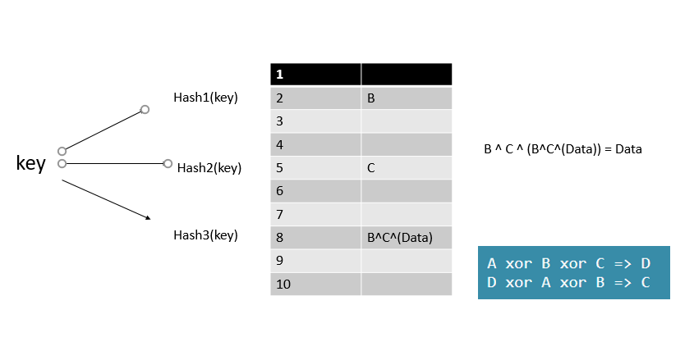
Background (Bloomier Filter )
Notes:
When the controller is responsible for all the tasks it becomes a bottleneck and the solution does not scale well. (reason 2)

Slide 8
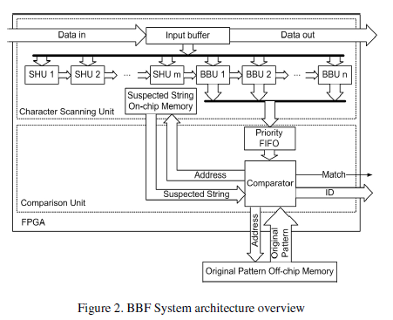
System Architecture
Notes:
The OpenSec framework :
Security functions are provided by the processing units;
traffic is routed to each processing unit based on requiremens given through security policies;
the reaction to security alerts is automated.

Slide 9
System Architecture
Our BBF system in Fig. 2 .
It includes a Character Scanning Unit, a Comparison Unit and an Off-chip Memory to store original patterns.
There are 3 main components in Character Scanning Unit: Standalone Hash Unit (SHU), Bloom –Bloomier Unit (BBU) and On-chip Memory to store suspected
strings.
If one of BBUs signals a match, the address of correlated original pattern and current scanning string (suspected string) are passed to Comparison Unit to determine whether that string is identical with original pattern.
When the exact match is confirmed, our system reports this match together
with ID of the pattern.

Slide 10
System Architecture
Character Scanning Unit :
Our solution is to combine Bloomier Filter with Bloom Filter in order to minimize the comparison process which requires accessing to low-speed off-chip memory.
We use one more bit in the index table entry, called "Bloom bit“.
All of the Bloom bits in index table act as an independent Bloom Filter. We use this Bloom Filter to check whether the query string may be in the set.
If all of Bloom bits in hashed positions are ‘1’, we decode the information from Bloomier encoded bits then start comparing the string.
Notes:
We have to access off-chip memory to do comparison for every searched string.
At this point, Bloomier Filter is worse than Bloom Filter which just performs comparison when all of bits in hashed-positions are ‘1’.

Slide 11
System Architecture
Another problem with this structure is the limitation of SRAM-based FPGA chips.
k hash functions require k random lookups to the memory (index table) in a single clock cycle, whereas SRAM-based FPGA only supports 2 queries at a time.
To solve this problem, we break Bloomier bits into (k/2) parts, encode them into (k/2) separated index tables. Hence k hash functions are used, each pair of them corresponds to one index table.

Slide 12
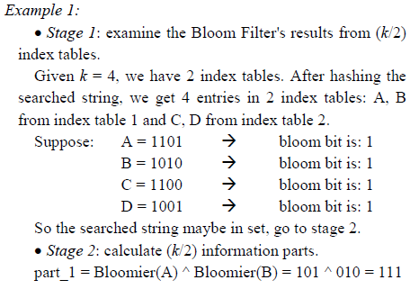
System Architecture
Example 1 demonstrates the operation of Bloom – Bloomier Filter :

Slide 13
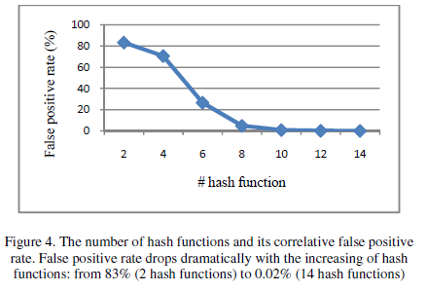
System Architecture
Hash Function Consideration
The number of hash functions used in BBF has major impact on system
performance because it affects the false positive rate of filter.
High false positive rate means there will be more suspected strings need to be checked .

Slide 14
System Architecture
Comparison Unit
It has 2 parts: the Priority FIFO Module and Comparator Module.
Priority FIFO : Collect all output data of BBU , and pass it to Comparator one by one.
Comparator Module : Reads data from Priority FIFO, uses this information to compare original pattern from off-chip memory and corresponding suspected string from on-chip memory.
Whenever an exact match is detected, the comparator will report the pattern’s ID, terminate the system till the next stream arrives.
Notes:
We connect all output data of BBU-FIFOs to a common bus and selectively fetch
BBU-FIFOs’ content to Priority FIFO.

Slide 15
System Architecture
Database update
Our system mostly relies on memory: on-chip memory stores index tables and off-chip memory stores original patterns Content.
To remove a pattern out of database, we simply change the value of pointer in off-chip memory to null, when the Comparator notices this invalid value, it drops
current suspected string, proceeds to examine the next string.
Adding new patterns is not easy as removing. The software running on PC has to re-construct the index table then transmit new index table’s value via Communication Module in BBF system to replace old index table.

Slide 16
FPGA Performance Implementation
Our system is implemented on the Altera DE2 Development and Education board. The FPGA chip in DE2 is Cyclone II EP2C35F672C6. We use Quartus II 9.1 Web Edition for hardware synthesis, mapping, placing and routing.
We only implement the patterns of lengths from 10 to 20 characters. There are 2751 patterns with total of 43,951 characters in this range.

Slide 17
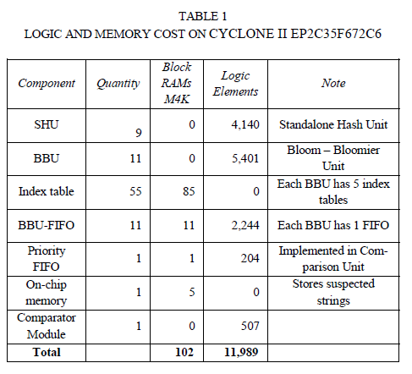
FPGA Performance Implementation

Slide 18
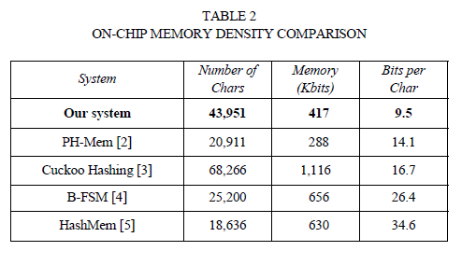
FPGA Performance Implementation

Slide 19
FPGA Performance Implementation
Because of the limitation of low-cost FPGA chip and of synthesis tool, our system can only operate at 128 MHz (1Gbps).
Table 1 is the list of hardware consumption for all components in the system which consists of 9 SHUs, 11 BBUs with their index tables and FIFO, Comparator Module, Priority FIFO and on-chip memory to save suspected strings.
Our system also uses 54.5 kilobytes available off-chip memory on DE2 board to store all original patterns.
Table 2 shows the comparison of our system with previous systems in on-chip memory usage.

Slide 20
Conclusion
Our system is an effective solution to accelerate the performance of pattern matching in ClamAV.
The novel aspect of this system is the combination of Bloom Filter and Bloomier Filter to minimize the off-chip memory access times for exact pattern comparison.
In near future, our system will support all ClamAV simple patterns and some kinds of wildcard.
We also intend to create a system called Hybrid Antivirus Solution, which is a combination of hardware and software to take full advantage of high speed
FPGA-based system as well as flexibility of PC application.
An anti-virus application running on PC uses some heuristic algorithms to discover unknown viruses while FPGA-based system scans the file stream in order to detect known viruses by their signatures.

